Slide 1
FEE MANAGEMENT SYSTEM
BY
K SAI SUPREETH-1BM15IS034
BADRINATH M -1BM15IS016

Slide 2
DESCRIPTION
The main objective of the application is to automate the existing system of manually maintain the records of student information, subjects, fee of exam also to make online payment and get the acknowledge to students.
The application should provide quick access to the records maintained and must reveal the subjects to register and pay through online for convenience of students.

Slide 3
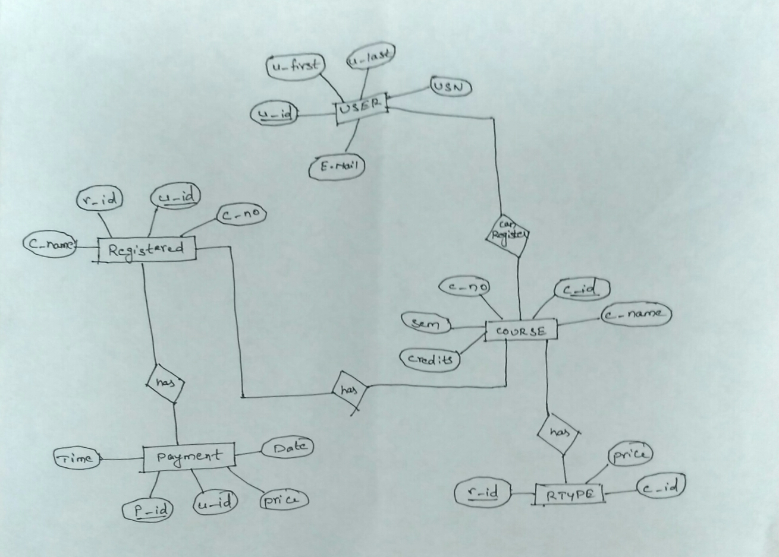
ER DIAGRAM

Slide 4
SQL TABLES
USER (U_ID PRIMARY KEY)
COURSE (C_ID PRIMARY KEY U_ID FOREIGN KEY)
RTYPE (R_ID PRIMARY KEY C_ID FOREIGN KEY)
REGISTERED (U-ID PRIMARY KEY (C_NAME,C_NO,R_ID) FOREIGN KEY)
PAYMENT (P_ID PRIMARY KEY U_ID FOREIGN KEY)

Slide 5
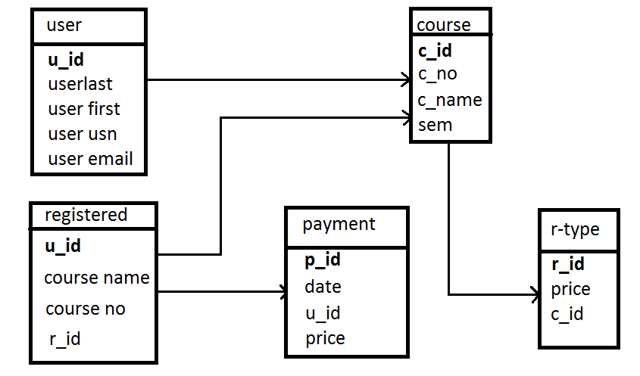
DATABASE SCHEMA

Slide 6
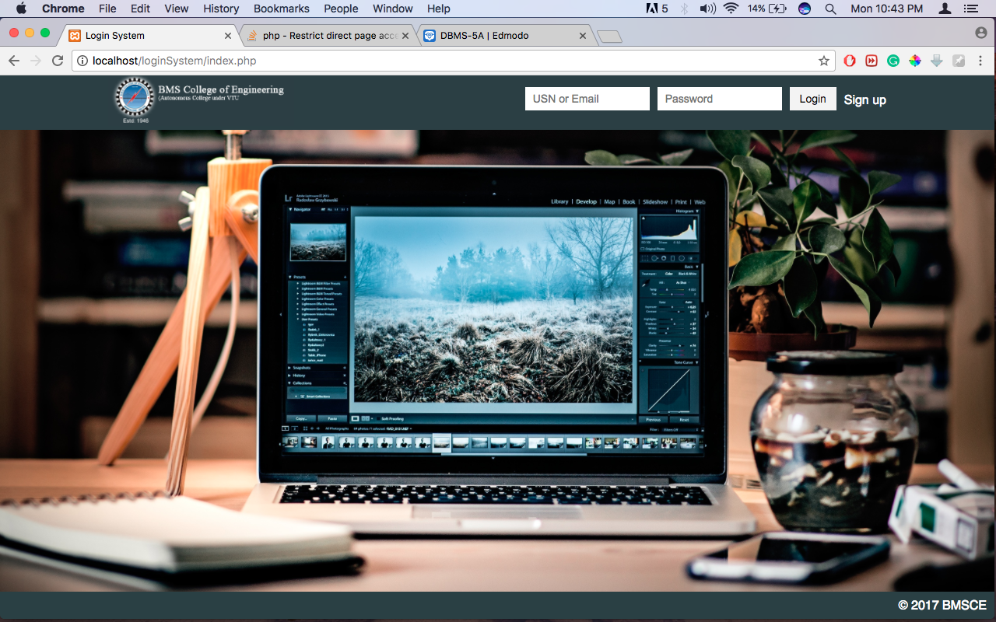
FRONT END SNAPSHOTS

Slide 7
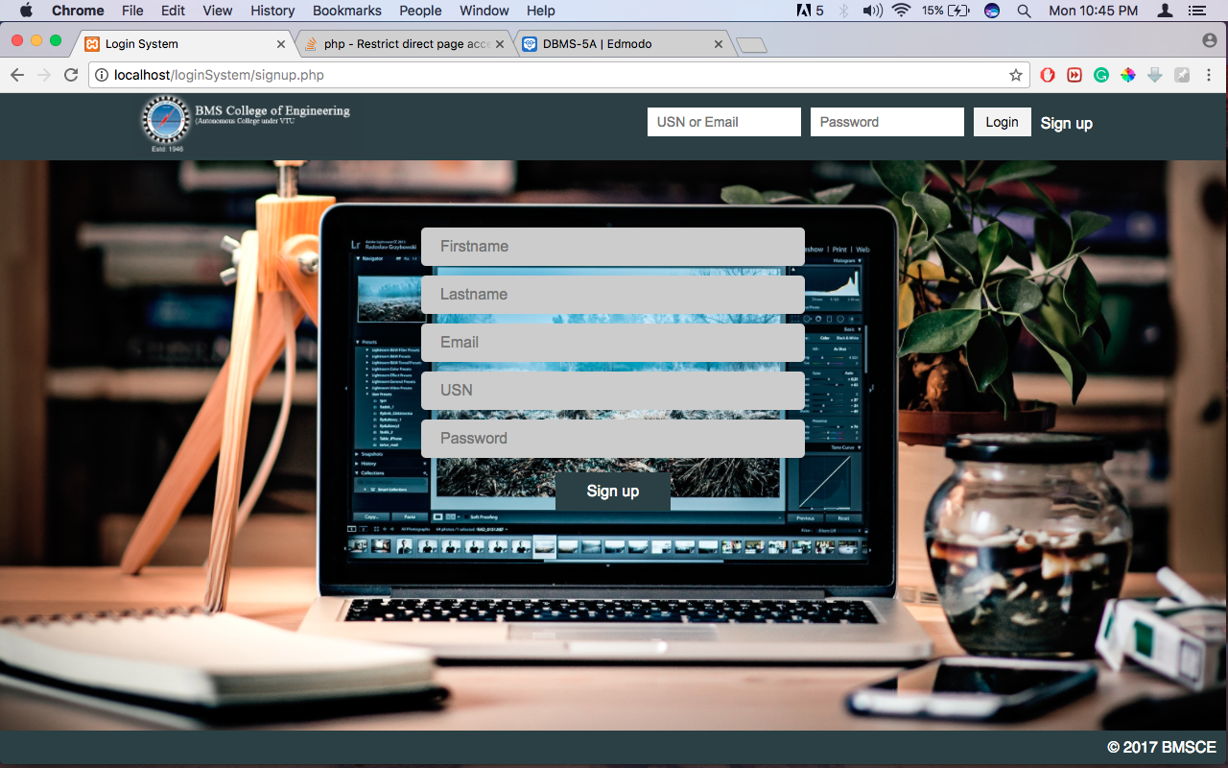

Slide 8


Slide 9
THANK YOU!!!

